Slide 1



Slide 2
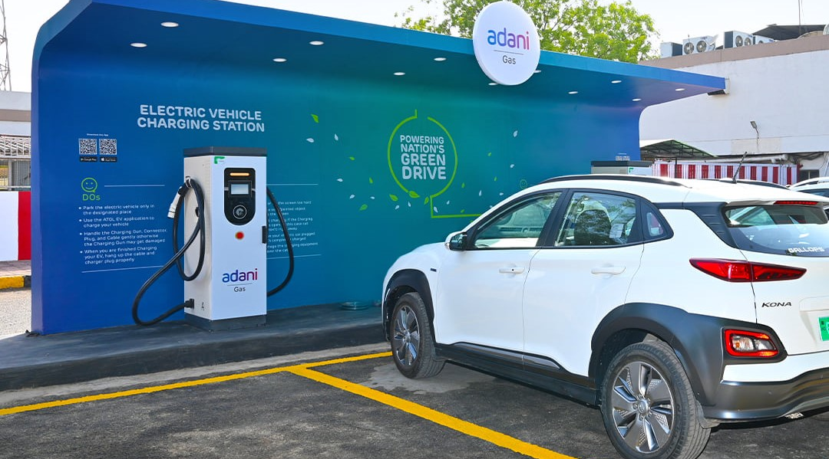
Adani
Total Energies
E-Mobility Limited (ATEEL)
“EV Charging”

Slide 3




Our Thought Process
Innovation
We take pride in
what we do
Always improving
We think differently
What does it take to achieve, business success as well as personal fulfillment in an organization?
Where has the element of pride and delight in work fizzled?
It servicing merely all about doing a job and delivering the expected or is it more than that?
Why does everything seem so superficial, stereotyped, following same old patterns lacking originality, confidence and trust?

Slide 4


MISSION
VISION
To be a dominant player in EV Charger Installer ecosystem by delivering world Class EV Charging Solutions that is IOT enabled, connected and backed by strong technology infrastructure.
To be one of the largest EV Charger Installer realizing the dream of providing easily ac accessible, convenient, clean and green EV Charging Solutions to different businesses and users.

Slide 5




Why EV?
EV Adaption:
Transforming India
Eco-Friendly Business Enabler
Reducing Air Pollution
Reducing Reliance on Fuel

Slide 6





ATEEL EV Charging as a Service
ATEEL Public & Captive Charging Solutions
Public Charging Network:
At a Glance!
Service Offerings

Slide 7









Sub-station work (Powerhouse)
Electric vehicle charging station
Civil and Interior work
EV
Charging
Services
Offering
Residential Societies & Complex
Hotels Highway Pitstops & Tourist Destinations
Oil & Gas Fuel Stations
Malls & Shopping Plazas
Fleet & Bus Hub Charging
Workplace & Institutions

Slide 8






DHBVN - Haryana
HVPNL - Haryana
Reliance BP mobility
Our Clients
Adani Total Energies
PWD B&R
Minder EV Logistics
Blue Smart Charge Pvt. Ltd

Slide 9








System Commissioning
System
Breakdown
Site
Scouting
Our
Working
Our Presence
Preventive Maintenance
Site Audit
In all over cities PAN India
Supply and Installation
Warehousing & Transportation
Canopy Works

Slide 10
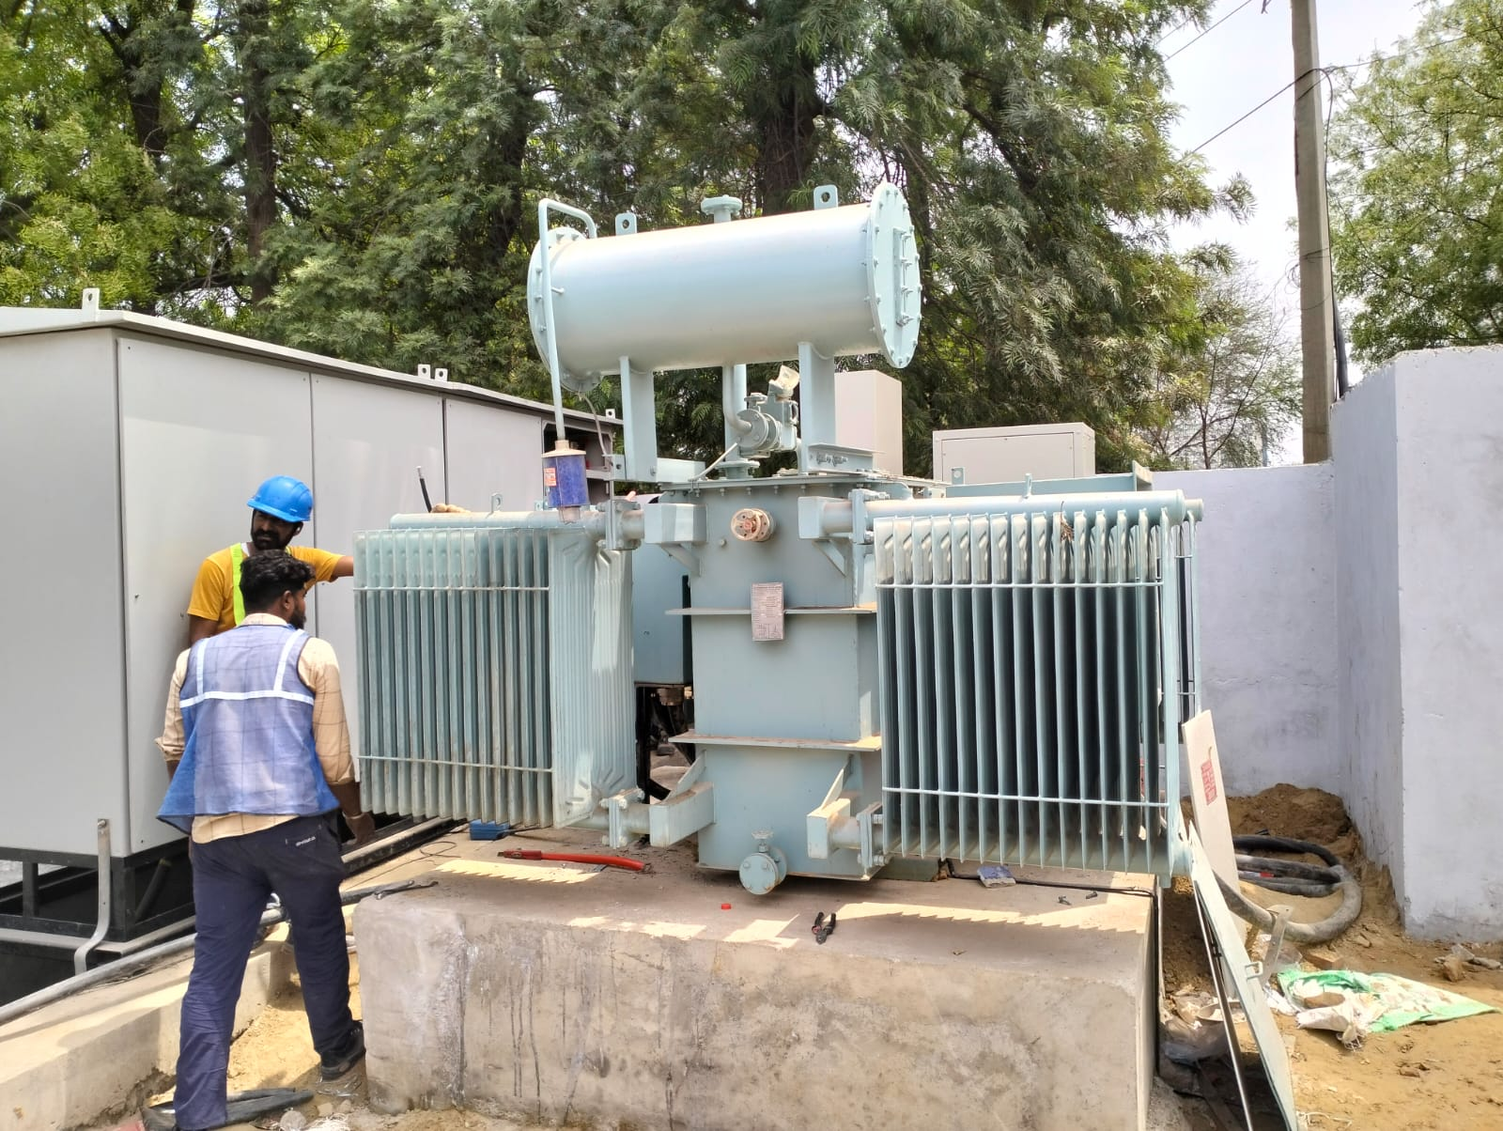
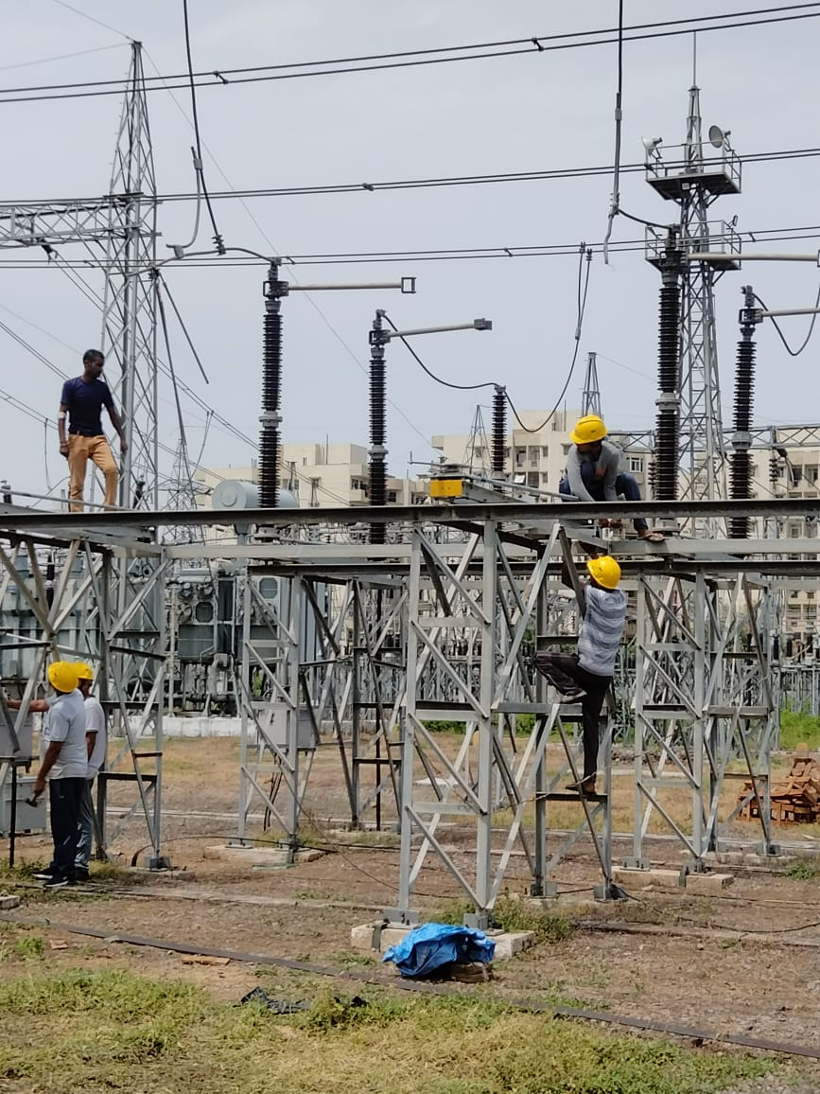
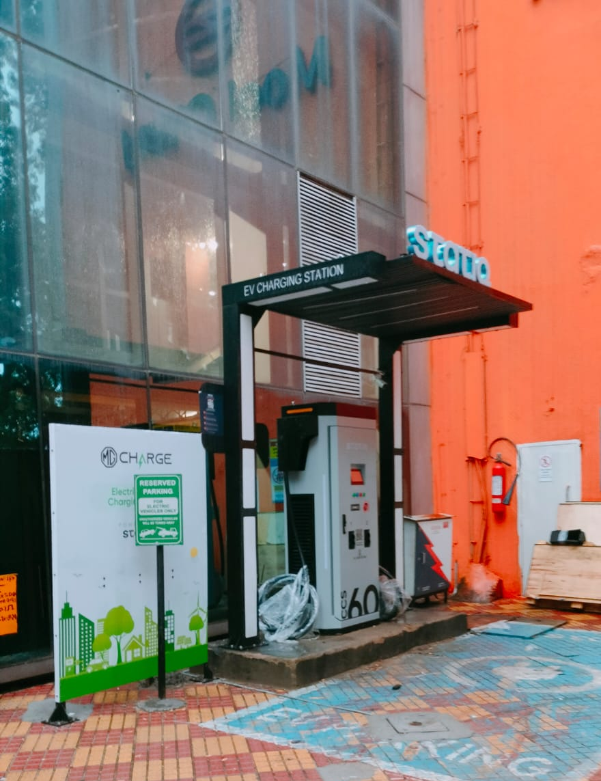
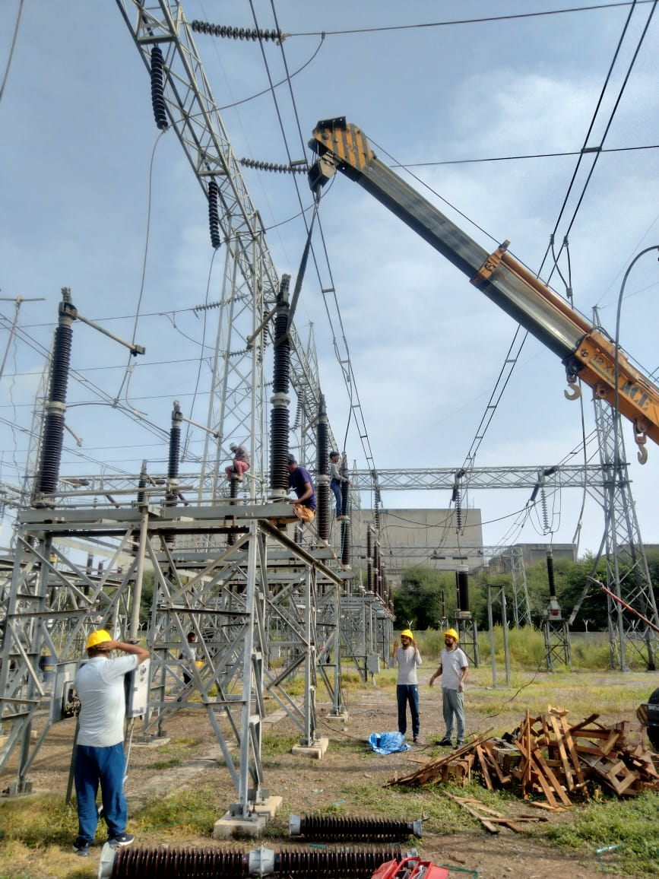
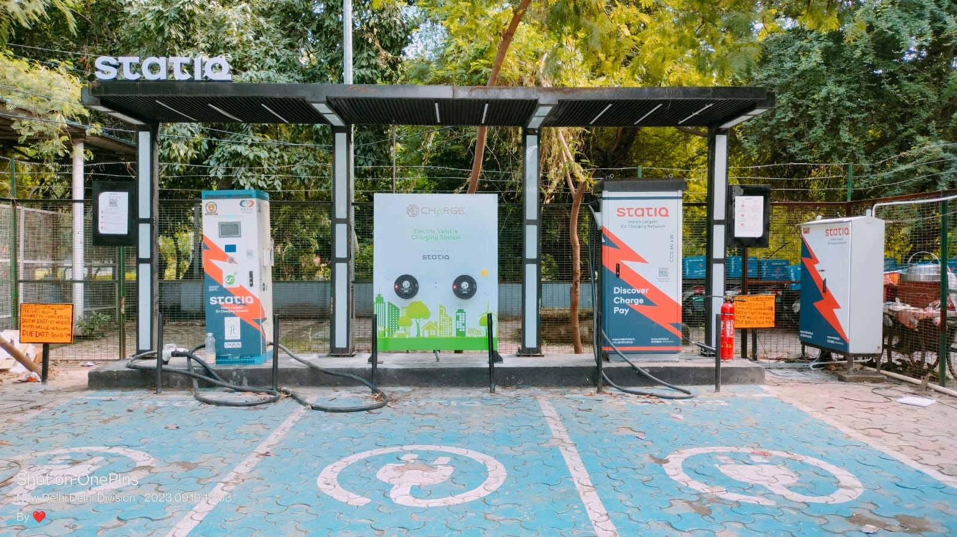
Installation snap

Slide 11
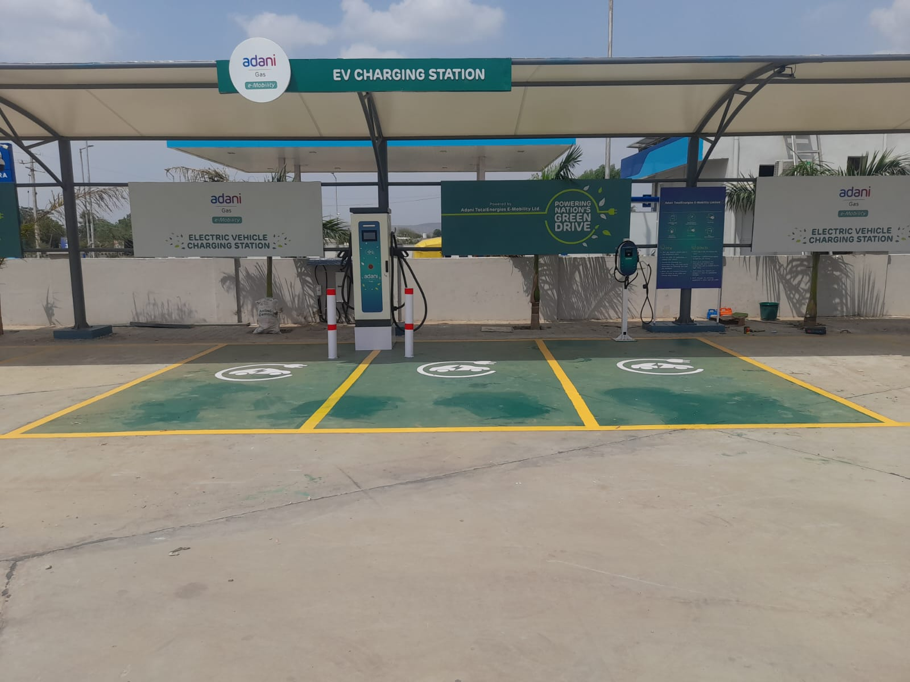
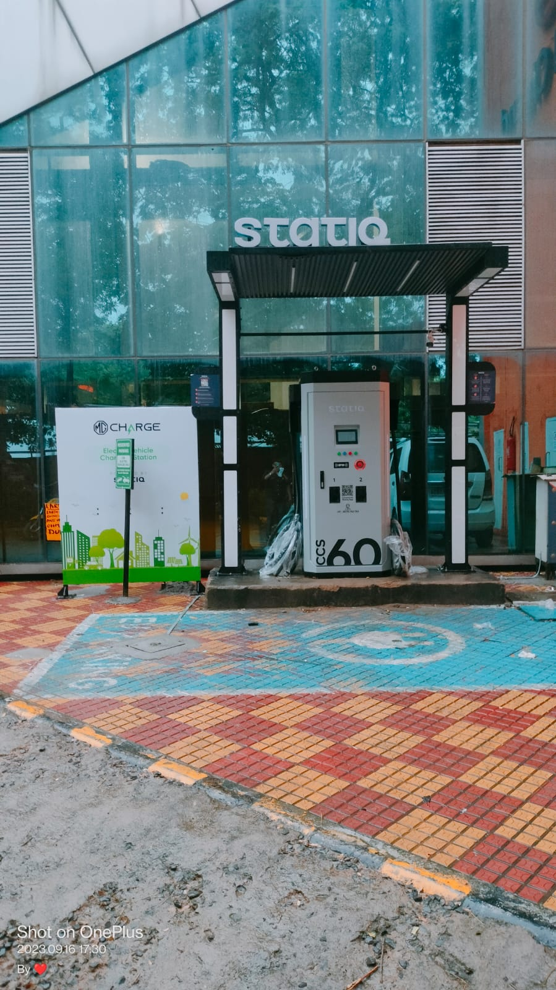
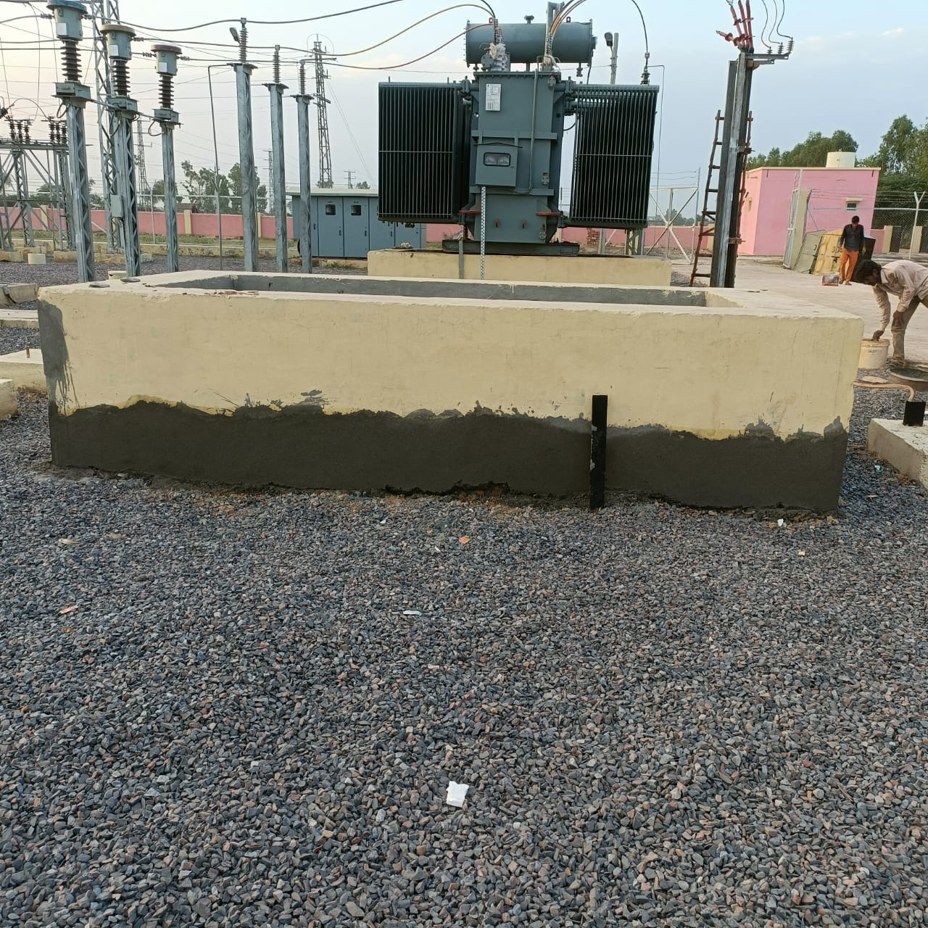
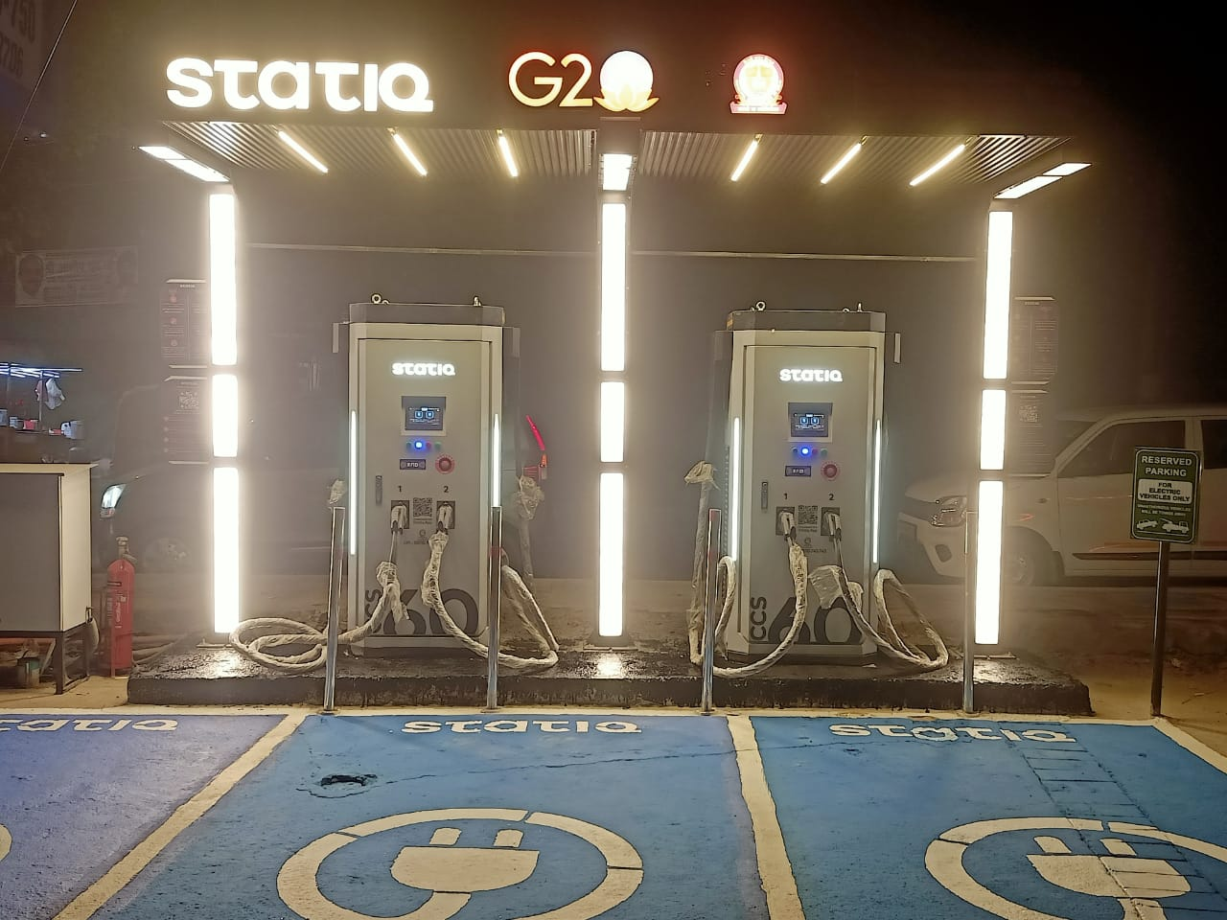
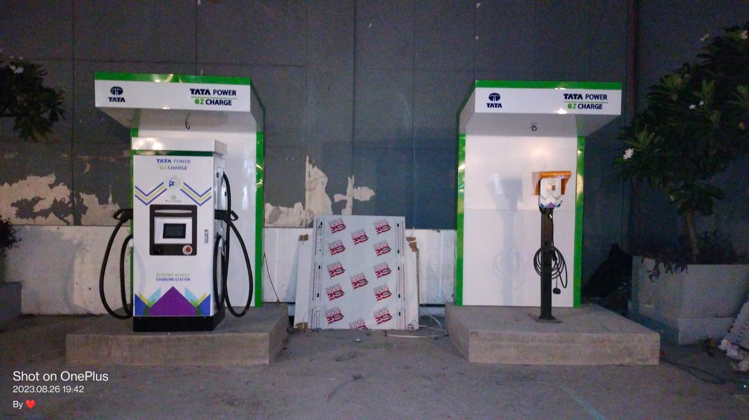
Installation snap

Slide 12
1500
KWh Energy Charged which is 2 years of household energy
Statistics
1.5 tons
1500+
C02e was not emitted
Chargers been installed
Our Presence
In all over cities PAN India
25000
Meters of
Cabling done
1.5 tons
C02e was not emitted

Slide 13





Mr. Samser Supervisor
Mr. Vinay Engineer
Mr. Harish Manager
Mr. Momin khan Civil Supervisor
Mr. Sanjay Civil Supervisor
Mr. Ramakant Allover Incharge
Our Staff
Address: 133, Sector 69, Tulip Avenue, Gurguram 122101
Call: 9990720017, 7042260017, 9802501071
Sales: 8882477422
Mail us: bknenterprises017@gmail.com

Slide 14
Thank You
Contact Us
FOR MORE QUERIES, PLEASE CONTACT US AT:
bknenterprises017@gmail.com

